Slide 1
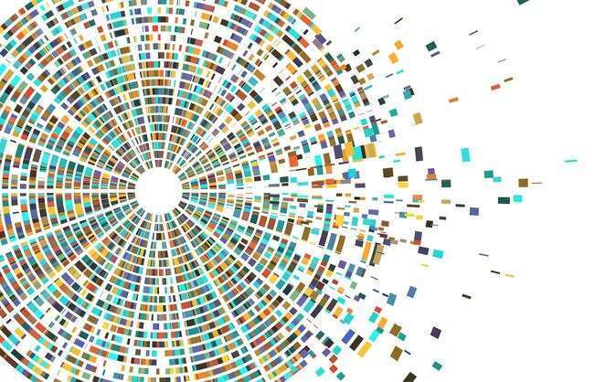
Evaluating Robustness of Computer Vision Models
Digital Image Processing – Final Project
Tehila Segal 324183870
Hadar Semama 212214902

Slide 2
PROJECT OVERVIEW
Goal, dataset, vision tasks, distortions, and evaluation pipeline.

Slide 3


Project Goal & Evaluation Pipeline
Evaluate how image distortions affect computer vision task performance,
and compare different recovery strategies.
01
02
03
04
05
06
Data Preparation
Baseline Evaluation
Robustness Testing
Recovery Evaluation
Model Adaptation
Final Analysis
Load the dataset and inspect the available annotations.
Run the selected vision tasks on clean images to establish reference performance.
Apply image distortions at multiple severity levels, run the selected vision tasks, and measure degradation.
Apply restoration methods to distorted images, rerun the selected vision tasks, and measure recovery.
Fine-tune the deep learning model on distorted images and evaluate robustness.
Compare task performance across clean, distorted, restored, and fine-tuned images using metrics, graphs, and visual examples.

Slide 4
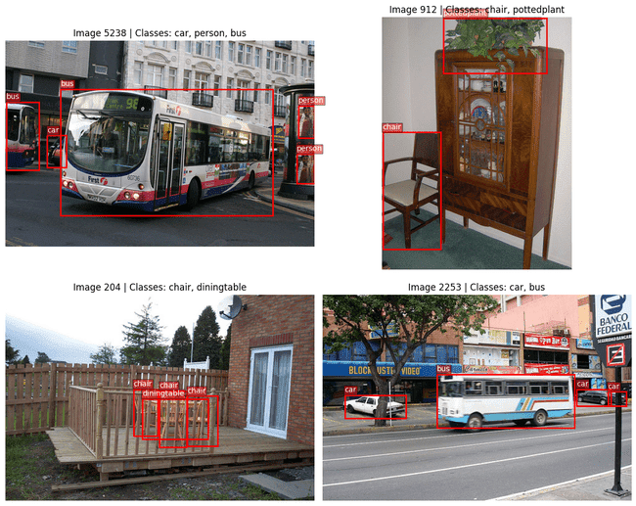
Project Setup
Dataset, vision tasks, distortions, and evaluation metrics selected for the robustness evaluation.
Dataset
Vision Tasks
Low-Level: Canny Edge Detection
Mid-Level: GrabCut Foreground Segmentation
High Level / DL: Multi-Label Classification with ResNet50
PASCAL VOC 2012 — RGB images with object labels, bounding boxes, and segmentation masks.
EVALUATION
DISTORTIONS
Salt & Pepper Noise
Overexposure
Motion Blur
Task-specific metrics:
Edge-Map IoU,
Segmentation IoU,
Multi-Label F1 / Jaccard,
and SNR.

Slide 5
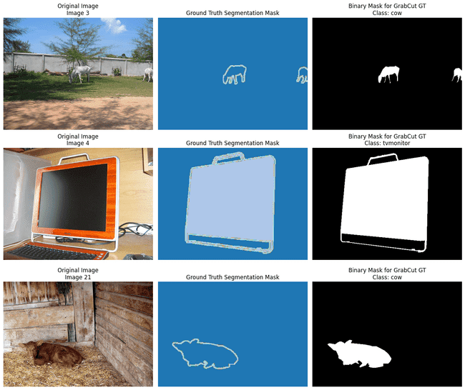
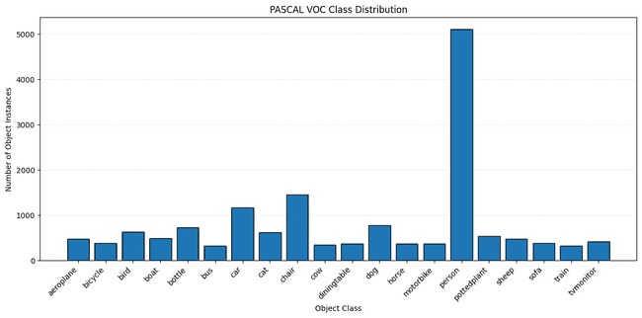
DATASET & ANNOTATIONS
PASCAL VOC 2012 provides the labels and ground truth needed for classification and segmentation-based evaluation
Class Distribution
Segmentation Ground Truth
Object-instance frequency per class.
Supports per-class performance analysis.
The dataset supports both multi-label classification and segmentation-based evaluation.
VOC masks are converted to binary masks
for GrabCut IoU evaluation.

Slide 6
CLEAN IMAGE BASELINE
Evaluating Canny, GrabCut, and ResNet50 on clean PASCAL VOC images.

Slide 7
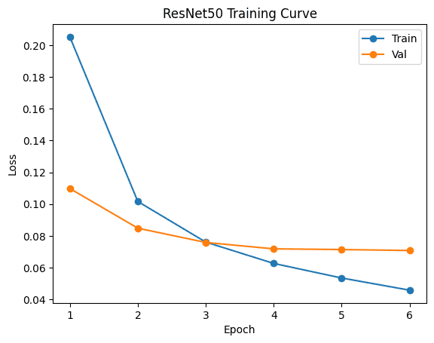
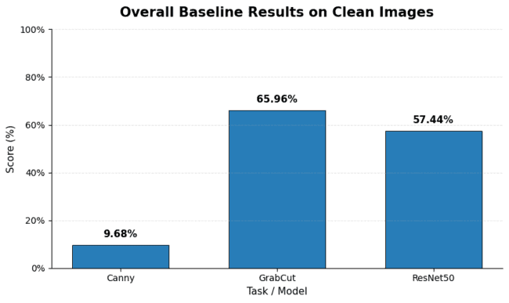
CLEAN BASELINE: QUANTITATIVE RESULTS
Each vision task was evaluated on clean PASCAL VOC images to establish reference performance.
9.68%
65.96%
57.44%
Canny Mean Edge Density
GrabCut Mean Segmentation IoU
ResNet50 Mean Jaccard / Label IoU
Note: Metrics are task-specific and should be interpreted separately.
Canny baseline uses edge density; distorted/restored results use Edge-Map IoU vs. the clean Canny reference.
Training loss decreases and validation loss stabilizes,
supporting the ResNet50 clean-image baseline.
Clean baseline = reference for distorted, restored, and fine-tuned results.

Slide 8
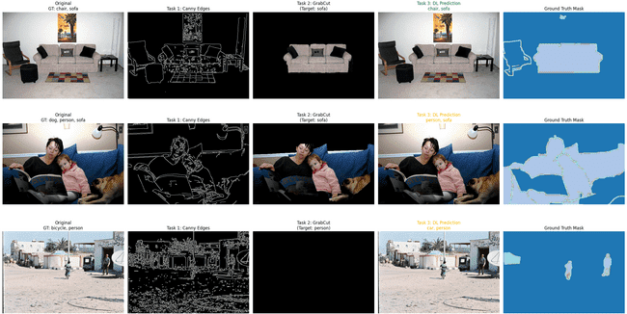
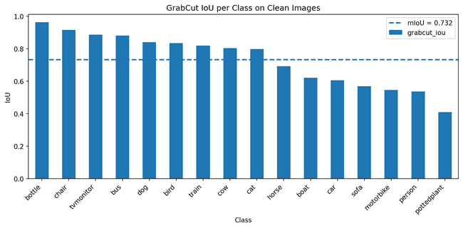
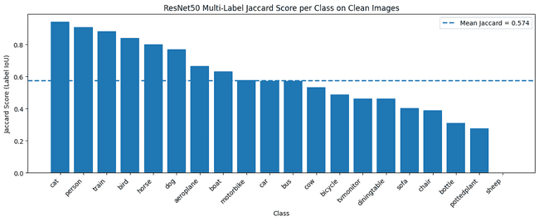
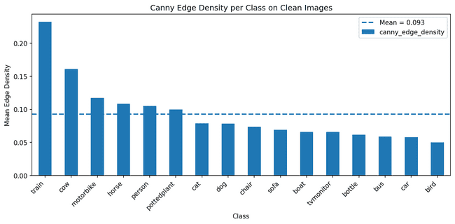
CLEAN BASELINE: VISUAL & PER-CLASS RESULTS
Clean-image outputs and per-class performance highlight task behavior before distortions.
Qualitative Task Outputs
Per-Class Baseline Analysis
Per-class analysis reveals category-level differences.
Original image → Canny edges → GrabCut output → ResNet50 prediction → Ground-truth mask
Clear object boundaries improve performance, while small or visually complex objects are more challenging.

Slide 9
ROBUSTNESS UNDER DISTORTIONS
Testing how Salt & Pepper noise, Overexposure, and Motion Blur affect each vision task.

Slide 10
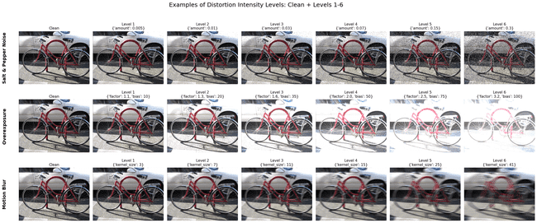
DISTORTION SETUP
Clean images were distorted using three degradation types at multiple severity levels to test robustness.
Salt & pepper
Random black/white pixels.
Creates false edges and noisy regions.
Overexposure
Increased brightness.
Causes saturation and loss of detail.
Motion Blur
Directional blur.
Removes sharp edges and boundaries.
Lower SNR indicates stronger image degradation.

Slide 11
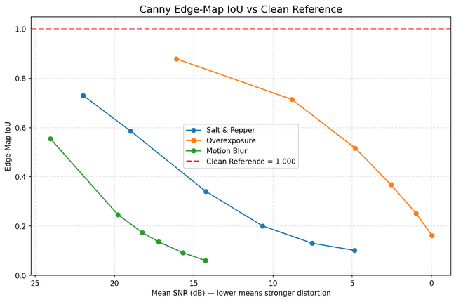
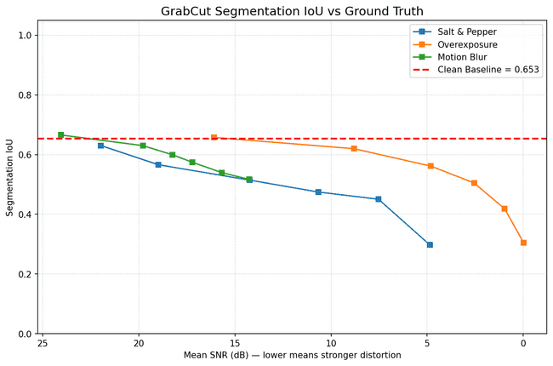
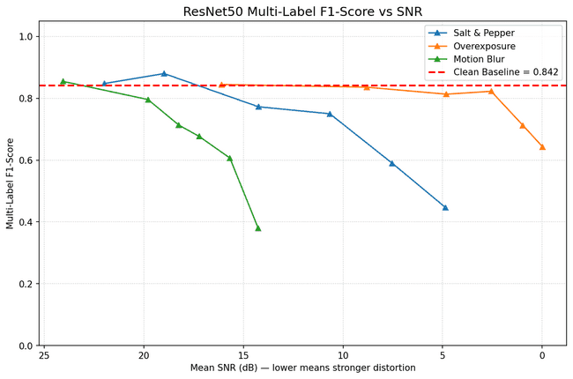
ROBUSTNESS RESULTS UNDER DISTORTIONS
Performance was measured after applying each distortion at multiple severity levels.
Canny is the most sensitive to distortions.
GrabCut drops when object boundaries or foreground/background separation are degraded.
ResNet50 is more stable under mild distortions, but degrades under severe noise and blur.
Stronger distortions generally reduce task performance, but the degradation pattern differs across tasks.

Slide 12
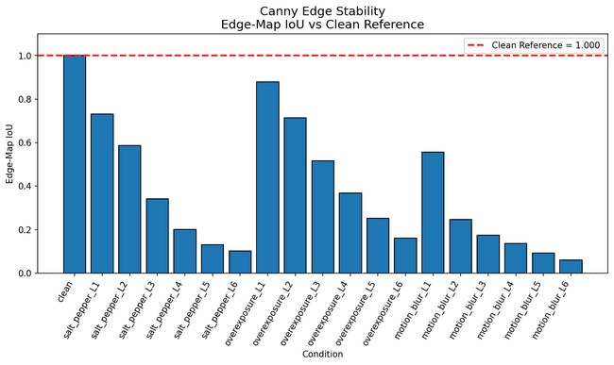
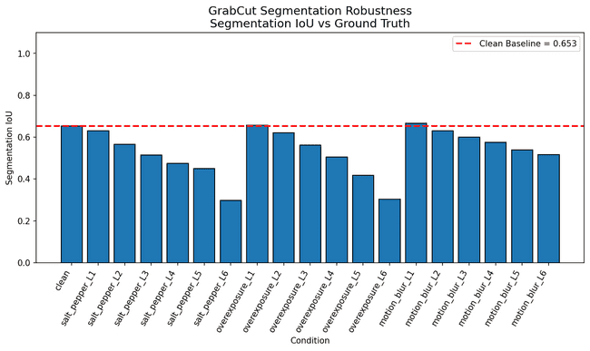
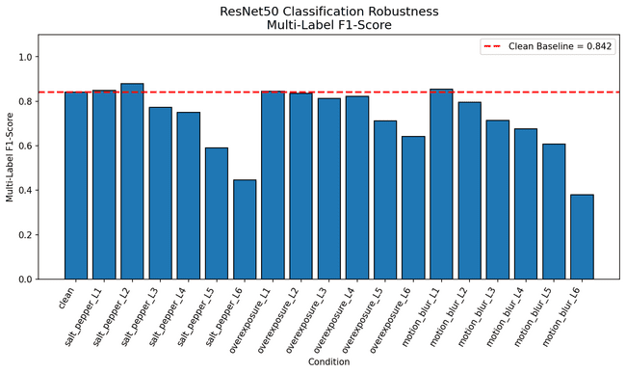
PERFORMANCE ACROSS DISTORTION LEVELS
Bar plots compare the clean reference with all distortion types and severity levels for each vision task.
Canny shows the strongest degradation as distortion severity increases.
GrabCut drops when object boundaries or foreground/background separation are degraded.
ResNet50 is more robust under mild distortions, but drops under severe noise and blur.
All tasks degrade with stronger distortions, but the rate of degradation differs by task.

Slide 13
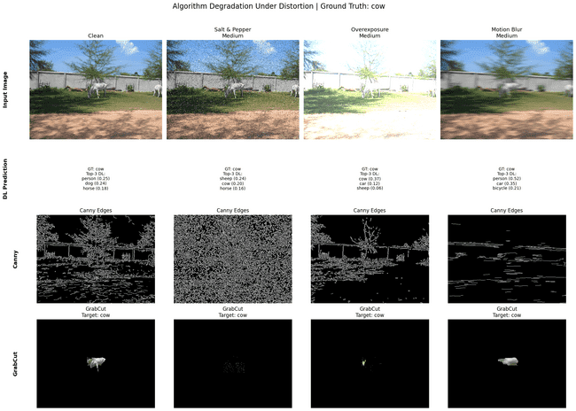
DISTORTED IMAGE TASK OUTPUTS
The same vision tasks were applied to distorted images to compare visual and quantitative degradation.
Salt & pepper
False edges and noisy structures
Overexposure
Washed-out regions and reduced contrast
Motion Blur
Blurred boundaries and fine detail loss
Visual degradation explains the metric drop observed in the robustness curves.

Slide 14
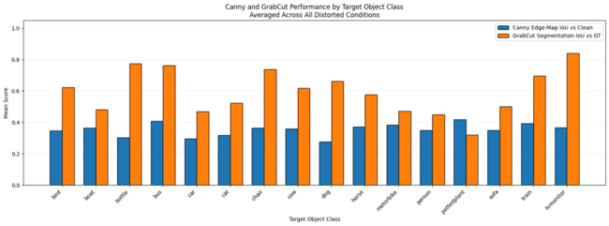
CANNY AND GRABCUT PERFORMANCE BY TARGET CLASS
Performance is grouped by the largest annotated target object in each image.
Canny is evaluated against the clean edge-map reference.
GrabCut is evaluated against the ground-truth segmentation mask.
Only classes represented in the segmentation subset are shown.
Performance varies across object classes because object size, boundary clarity, and foreground-background separation differ between categories.

Slide 15
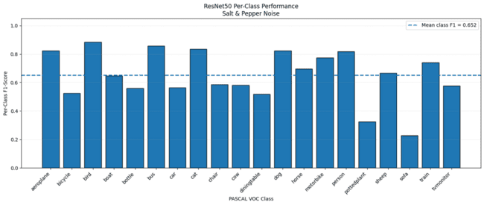
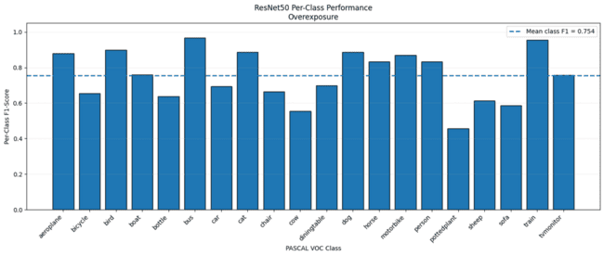
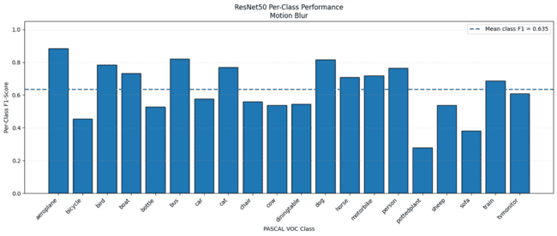
RESNET50 CLASS-SPECIFIC ROBUSTNESS
Class-specific F1 was evaluated across all six severity levels for each distortion.
Salt &Pepper
Overexposure
Motion blur
Mean F1: 0.652
Mean F1: 0.754
Mean F1: 0.635
Overexposure preserved the highest class-specific performance,
while Motion Blur caused the strongest degradation.

Slide 16
ROBUSTNESS KEY FINDINGS
Each distortion affects the tasks differently because it damages a different visual property.
SALT & PEPPER
OVEREXPOSURE
MOTION BLUR
SNR
SNR: 10.660
SNR
SNR: 5.164
SNR
SNR: 17.219
Canny: 0.201 -
highly sensitive to impulse noise.
Canny: 0.527 -
weakened edge information.
Canny: 0.136 -
strongly affected by edge smoothing.
GrabCut: 0.467 -
noisy object boundaries.
GrabCut: 0.561 -
affected by unclear boundaries.
GrabCut: 0.578 –
less accurate boundary localization.
ResNet50 F1: 0.700 - relatively stable under noise.
ResNet50 F1: 0.819 - moderately robust.
ResNet50 F1: 0.677 - affected by blurred appearance.
Creates false edges and noisy regions.
Causes saturation and loss of contrast.
Removes sharp edges and fine details.
Salt & Pepper mainly creates false structures, Overexposure removes contrast, and Motion Blur removes fine details; therefore each task fails for a different reason.

Slide 17
IMAGE RESTORATION
Applying distortion-specific restoration methods and measuring downstream recovery.

Slide 18
IMAGE RESTORATION SETUP
Distorted images were enhanced with distortion-specific restoration methods, then evaluated again.
SALT & PEPPER
OVEREXPOSURE
Motion Blur
Restoration:
Median Filtering
Goal:
Remove impulse noise while preserving object boundaries.
Restoration: Inverse Brightness Correction + CLAHE Goal: Reduce saturation and recover local contrast.
Restoration: Richardson-Lucy Deblurring + Artifact Reduction
Goal: Recover blurred edges while controlling artifacts.
Distorted vs restored images were compared using the same metrics:
Edge-Map IoU, Segmentation IoU, Multi-Label F1-Score, and SNR.

Slide 19
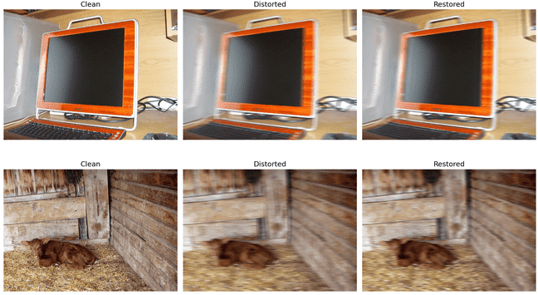
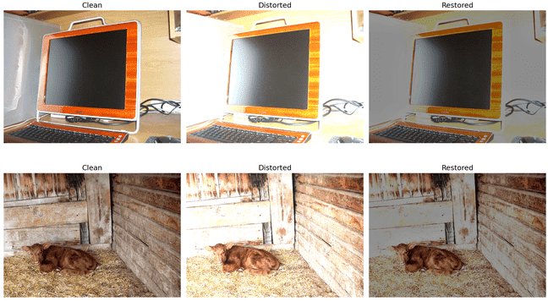
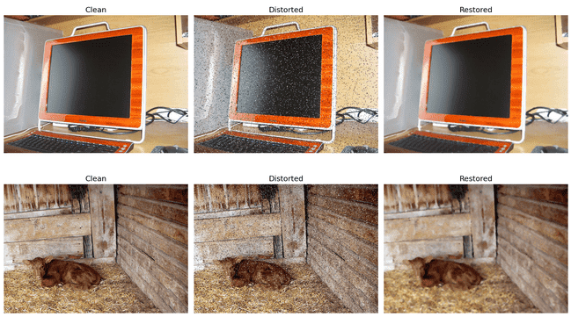
VISUAL RESTORATION EXAMPLES
Each distorted image was enhanced using a restoration method matched to its degradation type.
Motion Blur
Overexposure
Salt & Pepper
SALT & PEPPER
Deblurring recovers some edge sharpness.
Brightness correction restores contrast.
Median filtering removes impulse noise.
Visual recovery is strongest for Salt & Pepper noise and Overexposure.

Slide 20
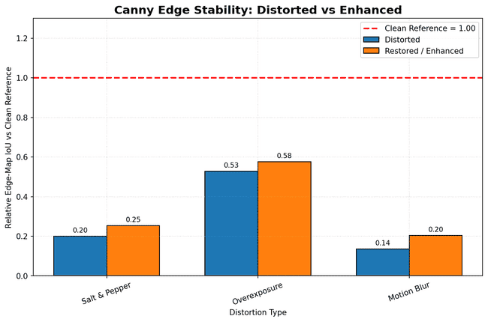
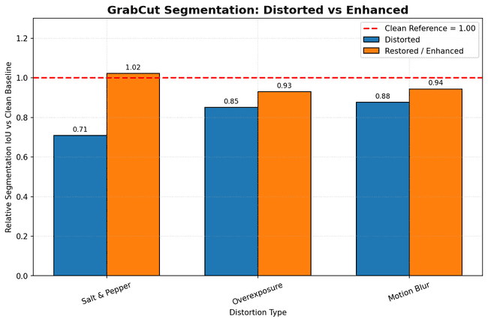
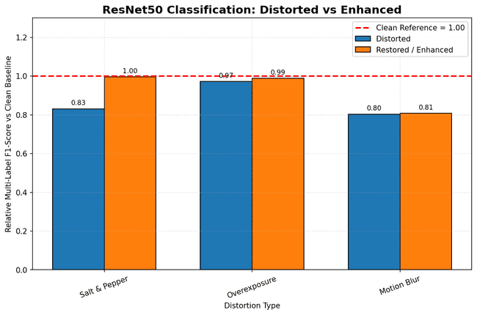
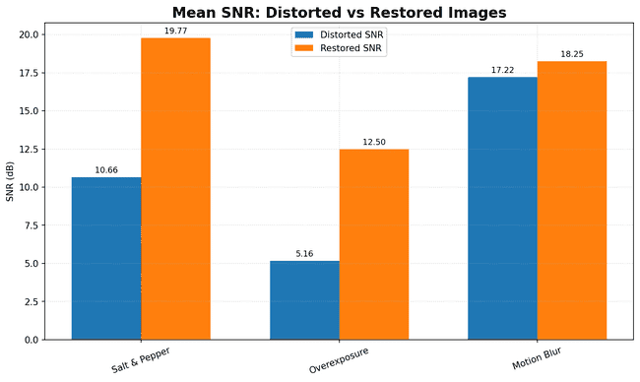
RESTORATION: QUANTITATIVE RESULTS
Distorted and restored images were compared using the same task-specific metrics.
Higher values indicate better recovery.
Restored results are compared
against distorted inputs
and the clean reference.
Restoration improves Salt & Pepper and Overexposure most clearly, while Motion Blur remains harder to recover.

Slide 21
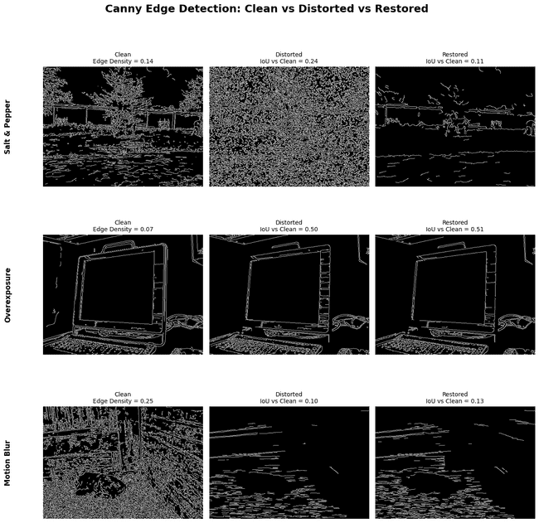
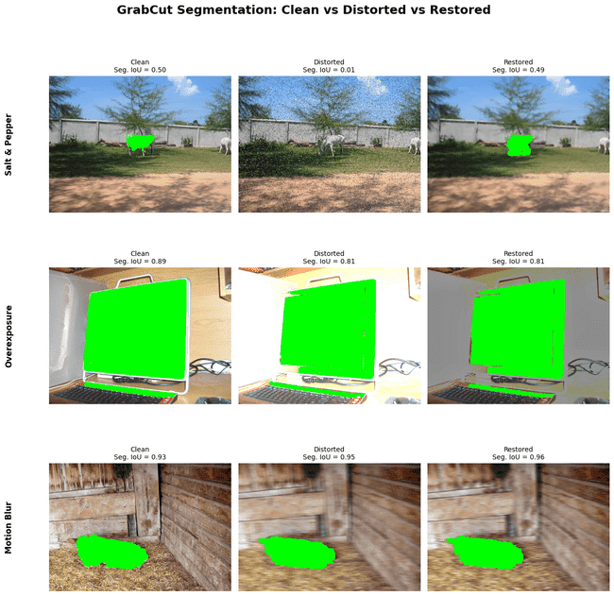
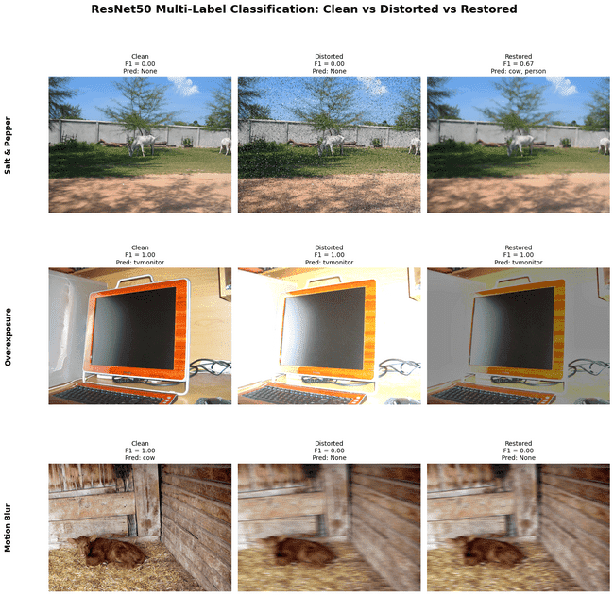
TASK OUTPUTS AFTER RESTORATION
Canny, GrabCut, and ResNet50 were re-run on clean, distorted, and restored images to evaluate downstream recovery.
Cleaner edge maps and fewer false edges.
Better object boundary recovery.
More stable predictions after enhancement.
Restoration is most visually effective for Salt & Pepper noise, with clear recovery in Canny and GrabCut, while Motion Blur remains the hardest case and ResNet50 improves only when object appearance is preserved.

Slide 22
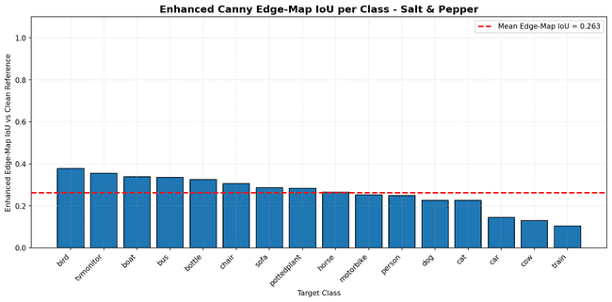
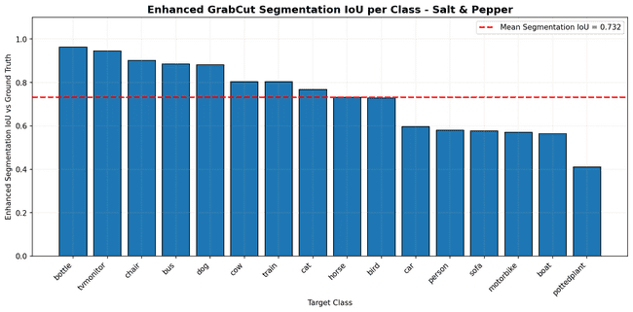
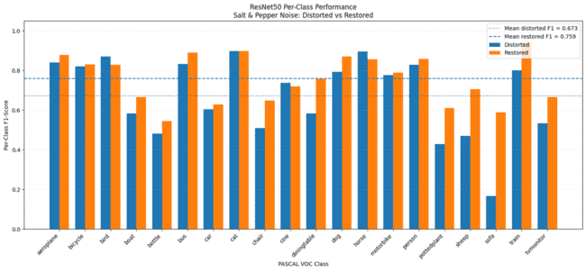
PER-CLASS PERFORMANCE: SALT & PEPPER RESTORATION
Median filtering improves class-level performance after Salt & Pepper degradation.
Canny
GrabCut
ResNet50
Noise removal reduces false edge responses.
Boundary recovery improves segmentation for clearer objects.
Mean class-specific F1 improves: 0.673 → 0.759
Salt & Pepper restoration shows the strongest class-level recovery,
with clear improvement in GrabCut segmentation and ResNet50 classification.

Slide 23
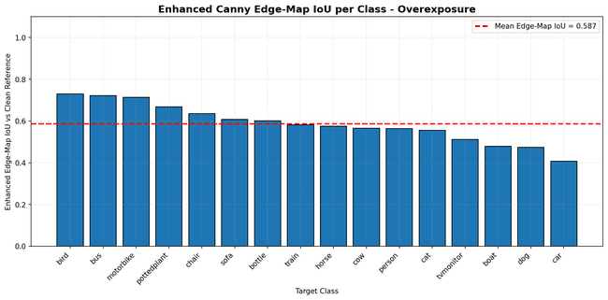
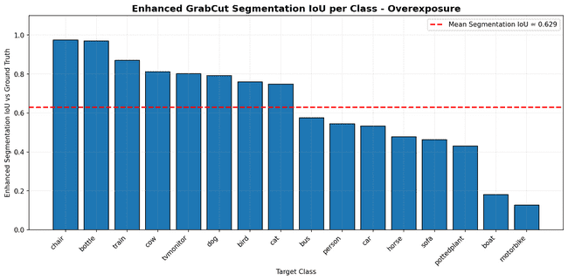
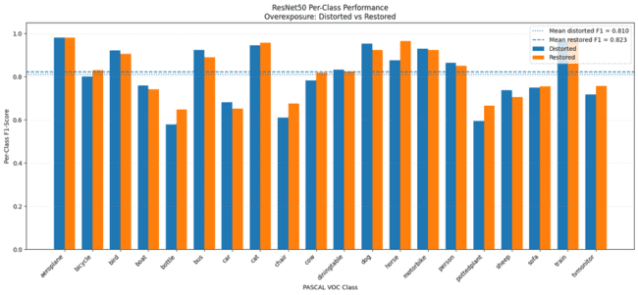
PER-CLASS PERFORMANCE: OVEREXPOSURE RESTORATION
Brightness correction and CLAHE improve class-level performance after overexposure degradation.
Canny
GrabCut
ResNet50
Contrast recovery improves edge-map similarity.
Restored contrast helps foreground/background separation.
Mean class-specific F1 improves slightly:0.810 → 0.823
Overexposure restoration mainly improves contrast-related performance, with moderate recovery in Canny and GrabCut and a slight improvement in ResNet50.

Slide 24
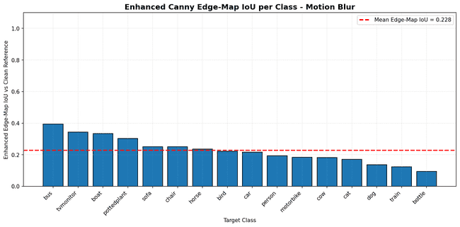
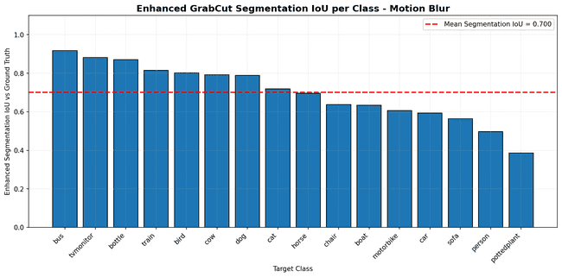
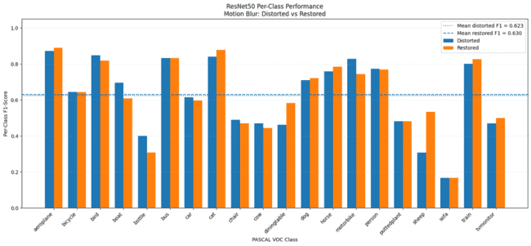
PER-CLASS PERFORMANCE: MOTION BLUR RESTORATION
Richardson-Lucy deblurring provides only partial class-level recovery after Motion Blur degradation.
Canny
GrabCut
ResNet50
Deblurring partially restores edge structure.
Boundary recovery gives limited segmentation improvement.
Mean class-specific F1 improves only slightly:0.623 → 0.630
Motion Blur remains the hardest distortion to recover, with partial improvement in Canny and GrabCut and only a slight gain in ResNet50.

Slide 25
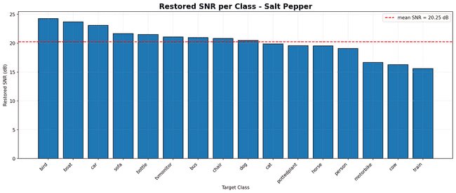
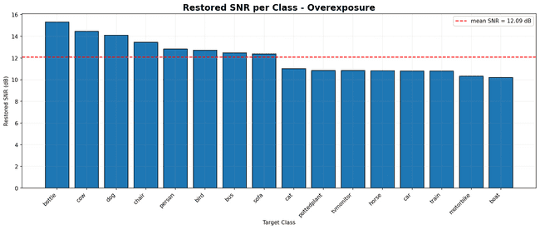
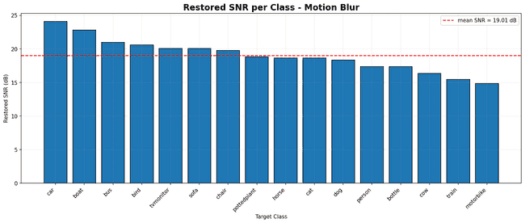
PER-CLASS SNR ON RESTORED IMAGES
SNR was measured per object class after restoration to compare image-quality recovery across distortions.
Salt & Pepper
Overexposure
Motion Blur
Median filtering gives the strongest SNR recovery.
CLAHE and brightness correction recover saturated regions.
High SNR does not fully recover lost fine details.
Per-class SNR supports the restoration analysis: Salt & Pepper shows strong image-quality recovery, while Motion Blur remains limited by lost fine details.

Slide 26
RESTORATION KEY FINDINGS
Restoration improved image quality and downstream task performance, but the level of recovery varied across distortions.
SALT & PEPPER
OVEREXPOSURE
MOTION BLUR
SNR
10.660 → 19.772
SNR
5.164 → 12.498
SNR
17.219 → 18.248
Canny: 0.201 → 0.253
Canny: 0.527 → 0.576
Canny: 0.136 → 0.204
GrabCut: 0.467 → 0.674
GrabCut: 0.561 → 0.613
GrabCut: 0.578 → 0.622
ResNet50 F1: 0.700 →0.839
ResNet50 F1: 0.819 → 0.833
ResNet50 F1: 0.677 → 0.680
Strongest overall recovery.
Median filtering removes impulse noise and improves all three tasks.
Moderate task recovery.
Brightness correction and CLAHE mainly improve contrast and image quality.
Weakest recovery, especially for classification.
Fine details remain difficult to restore.
Salt & Pepper restoration gives the strongest numerical recovery, while Motion Blur shows only limited improvement, especially in ResNet50 classification.

Slide 27
MODEL ADAPTATION
Fine-tuning the deep learning model to improve robustness under distorted images.

Slide 28
DISTORTION-AWARE FINE-TUNING SETUP
Two ResNet50 models were fine-tuned under identical settings; only the training inputs differed.
CLEAN-CONTROL
DISTORTION-AWARE
CONTROLLED SETTINGS
Additional fine-tuning on clean images
Same image labels
Same image indices
Reference for clean training
Additional fine-tuning on distorted images
Salt & Pepper
Overexposure
Motion Blur
Same checkpoint
Same train / validation split
Same batch order
Same optimizer
Same trainable layers
Same number of epochs
Clean inputs
Distorted inputs
Parameter
Setting
Training images
4,500 per model
Validation images
800
Epochs
8
Trainable layers
layer3 + layer4 + fc
Primary metric
Multi-label F1
Only intentional difference: clean training inputs vs. distorted training inputs.

Slide 29
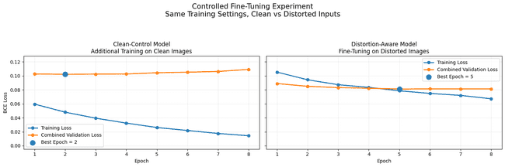
FINE-TUNING TRAINING BEHAVIOR
The selected checkpoint corresponds to the epoch with the lowest combined validation loss on clean and distorted images.
Clean-Control Model Best epoch: 2
Best loss: 0.1022
Distortion-Aware Fine-Tuned Model
Best epoch: 5
Best loss: 0.0811
Distortion-aware fine-tuning achieves a lower validation loss
and remains more stable during training.
The Clean-Control model begins to overfit after epoch 2, while the Distortion-Aware model continues improving until epoch 5.

Slide 30
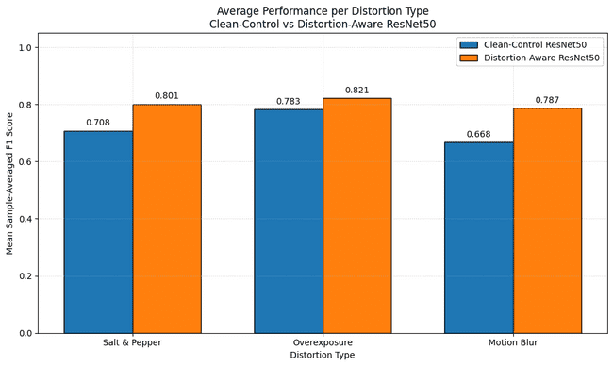
FINE-TUNING IMPROVES ROBUSTNESS
Mean F1 across all 18 distorted-image conditions on the same 400 validation images.
Mean F1 Across All Distorted Conditions
0.7195 → 0.8031
Clean-Control Distortion-Aware
+0.0837
~11.6%
absolute improvement
relative improvement
Distortion
Average gain
Salt & Pepper
+0.0925
Overexposure
+0.0388
Motion Blur
+0.1197
Largest average improvement: Motion Blur

Slide 31
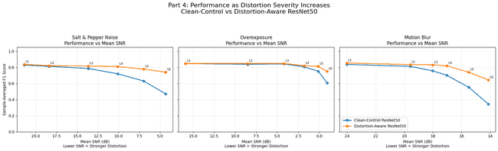
ROBUSTNESS AS DISTORTION SEVERITY INCREASES
The gap between the models becomes larger when SNR decreases and degradation becomes stronger.
Strongest level
Clean-Control
Distortion-Aware Fine-Tuned Model
Improvement
Salt & Pepper L6
0.4698
0.7395
+0.2697
Overexposure L6
0.6074
0.7502
+0.1428
Motion Blur L6
0.3442
0.6441
+0.2999
Fine-tuning provides the largest gains at the strongest distortion levels.

Slide 32
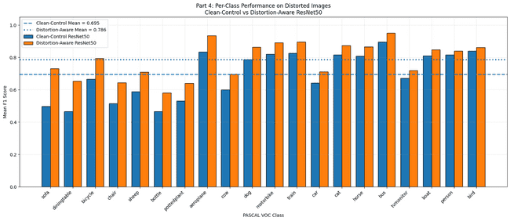
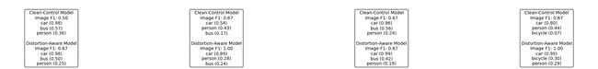
PER-CLASS AND PREDICTION RESULTS
Improvements appear across object classes and in individual distorted-image predictions.
Mean per-class F1
0.695 → 0.786
Largest class gains
Sofa, Dining Table, Bicycle,
Chair, and Sheep improved most.
All 20 PASCAL VOC classes improved on average.
Prediction example:
The fine-tuned model maintains high confidence
for the correct car label and generally reduces
confidence in incorrect labels under distortion.
Prediction Comparison: Clean-Control vs. Distortion-Aware ResNet50 Ground Truth: car
Clean
SNR = inf
Salt & pepper L4
SNR = 12.36 dB
Overexposure L4 SNR = 5.14 dB
Motion Blur L4
SNR = 18.11 dB

Slide 33
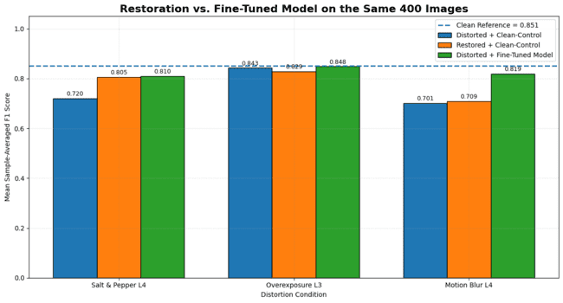
RESTORATION VS. FINE-TUNED MODEL
Direct comparison on the same 400 validation images
Salt & pepper
Restoration and fine-tuning are nearly identical. 0.805 vs. 0.810
Overexposure
Restoration slightly reduces F1. Fine-tuned model performs best: 0.848
Motion Blur
Fine-tuning is much more effective than restoration. 0.709 vs. 0.819
Fine-tuned model provides the strongest and most consistent classification robustness.

Slide 34


Overall Project Conclusions
Different tasks require different robustness strategies.
Canny
GrabCut
ResNet50
Restoration improved edge-map similarity but did not fully recover the clean reference.
Restoration improved segmentation under all distortions, especially Salt & Pepper noise.
Fine-tuning provided the strongest and most
consistent classification robustness.
Restoration achieved nearly identical recovery
under Salt & Pepper noise.
Different tasks benefit from different robustness strategies:
image restoration is effective for recoverable visual distortions,
while distortion-aware fine-tuning is strongest for high-level classification.

